Slide 1
Project Report on Survey Management
Submitted BY: gurpreet singh Submitted TO:- MR MUKESH JANGID Id:- 1911985031

Slide 2
Purpose OF PROJECT
The main aim of developing this online survey system is to conduct an online survey on different topics to the users. In this Java Application, the user can take part in various online polls. In this system of survey, only the users registered in the database system can drop their vote or express their viewpoint regarding the issue. Being online software, it can be logged on from anywhere with internet access. Admin in this application will add the polls regarding different questions and different topics and he can see the results of each poll in the pie chart.
Overall this project of ours is being developed to help the person taking the survey as well as person giving the survey in the best way possible and also reduce the human efforts.

Slide 3
Description Of topic
The project aims and objectives that will be achieved after completion of this project are discussed . The aims and objectives are as follows:
Ability to take survey online
User login page where user can give survey created by admin
A separate column for polls
An admin login page where admin can create Survey
A page which shows result of survey
A page where admin can add Question to existing Survey

Slide 4
Technologies used
FRONT-END
:- Angular JS
BACK-END
:- Spring-Boot
DATABASE
:- MY SQL

Slide 5
FRONTEND:- Angular js
Angular is an application design framework and development platform for crearting efficient and sophisticated single-page apps.
Angular is a development platform, built on TypeScript As a platform, Angular includes:
A component-based framework for building scalable web applications
A collection of well-integrated libraries that cover a wide variety of features, including routing, forms management, client-server communication, and more
A suite of developer tools to help you develop, build, test, and update your code

Slide 6
Back-end:- Springboot
Spring Boot helps you to create stand-alone, production-grade Spring-based applications that you can run
Spring Boot is used to create Java applications that can be started by using java -jar or more traditional war deployments. We also provide a command line tool that runs “spring scripts”.
Our primary goals are:
• Provide a radically faster and widely accessible getting-started experience for all Spring development.
• Be opinionated out of the box but get out of the way quickly as requirements start to diverge from the defaults. • Provide a range of non-functional features that are common to large classes of projects (such as embedded servers, security, metrics, health checks, and externalized configuration).
• Absolutely no code generation and no requirement for XML configuration.

Slide 7
Database:-my-sql
MySQL, the most popular Open Source SQL database management system, is developed, distributed, and supported by Oracle Corporation.
Some Of the features are:
Works on many different platforms.
Written in C and C++.
Uses multi-layered server design with independent modules.
Designed to be fully multithreaded using kernel threads, to easily use multiple CPUs if they are available.
Provides transactional and non-transactional storage engines.
Uses a very fast thread-based memory allocation system.

Slide 8
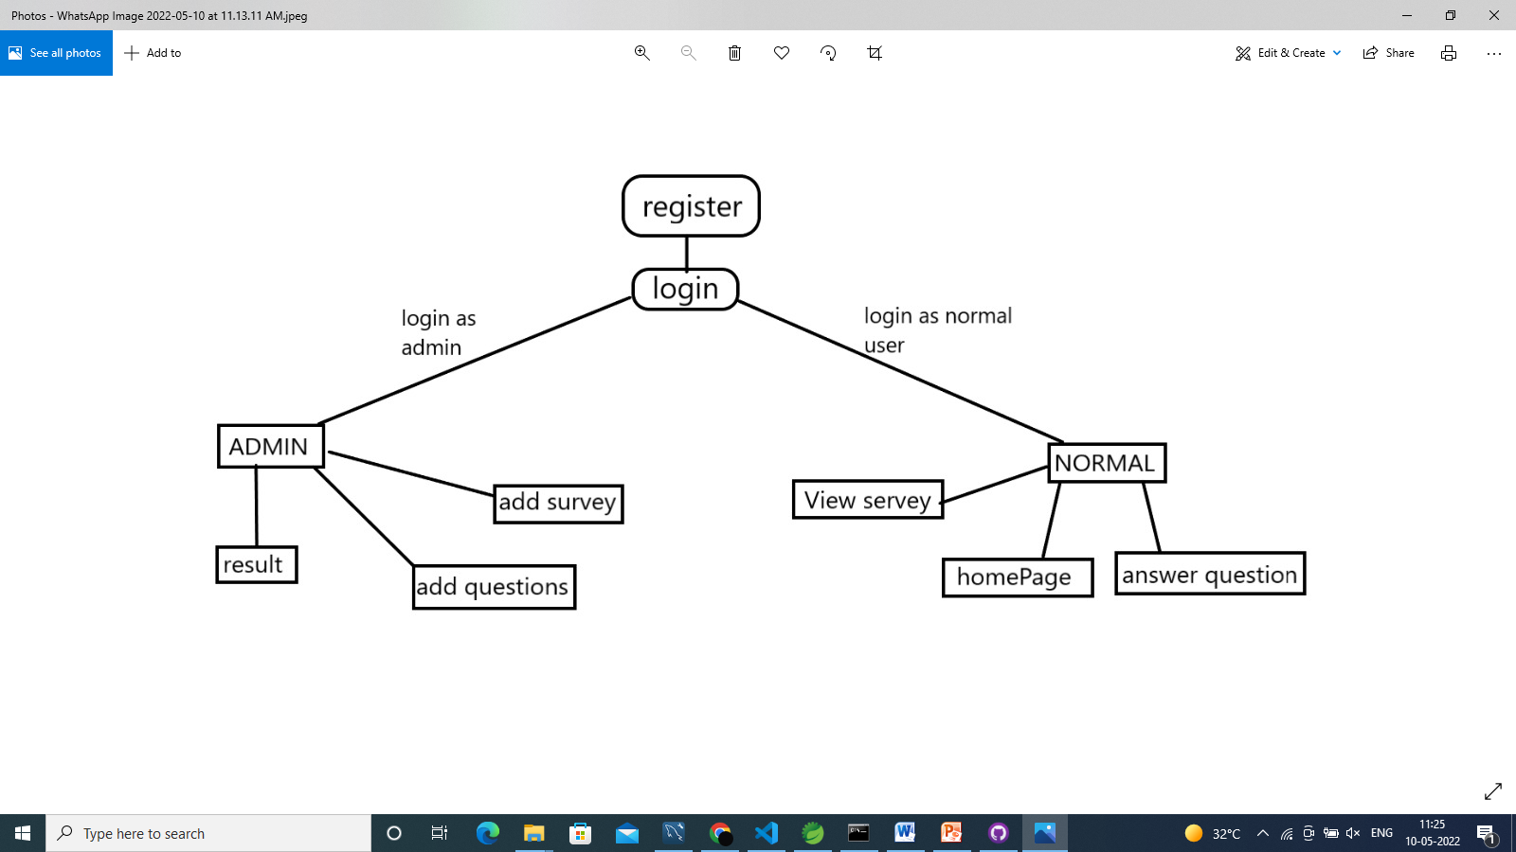
Data flow diagram

Slide 9
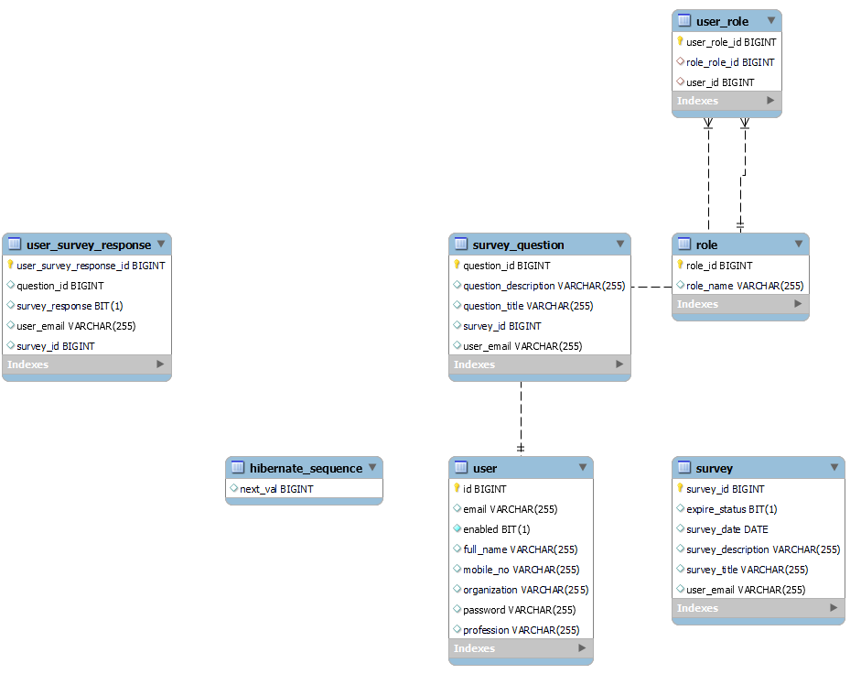
ER DIAGRAM

Slide 10
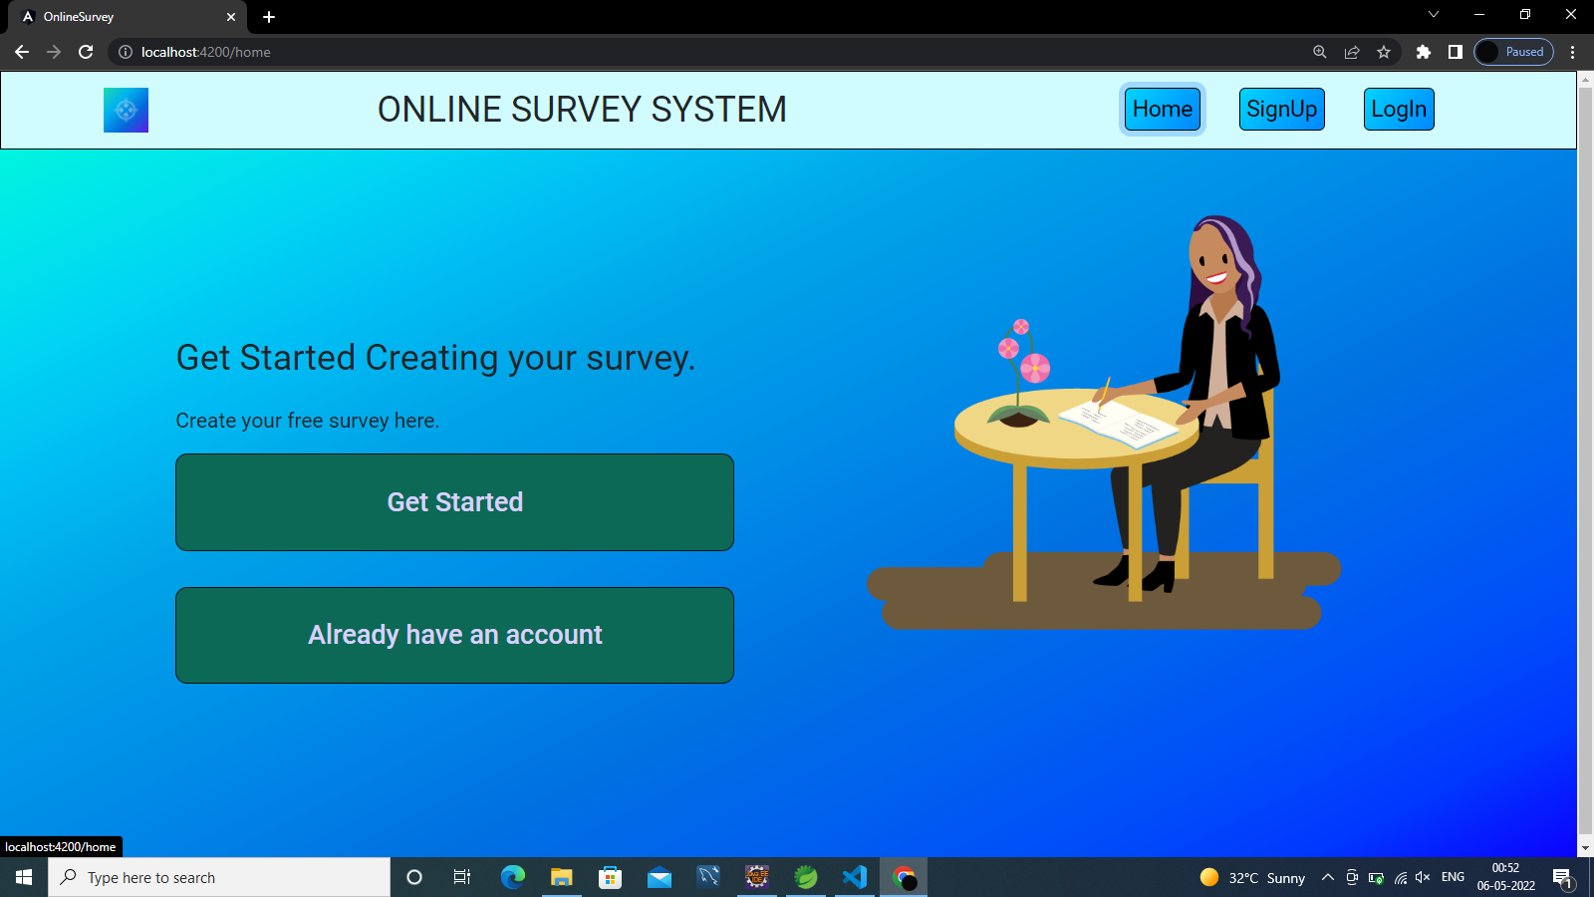
Screenshots

Slide 11
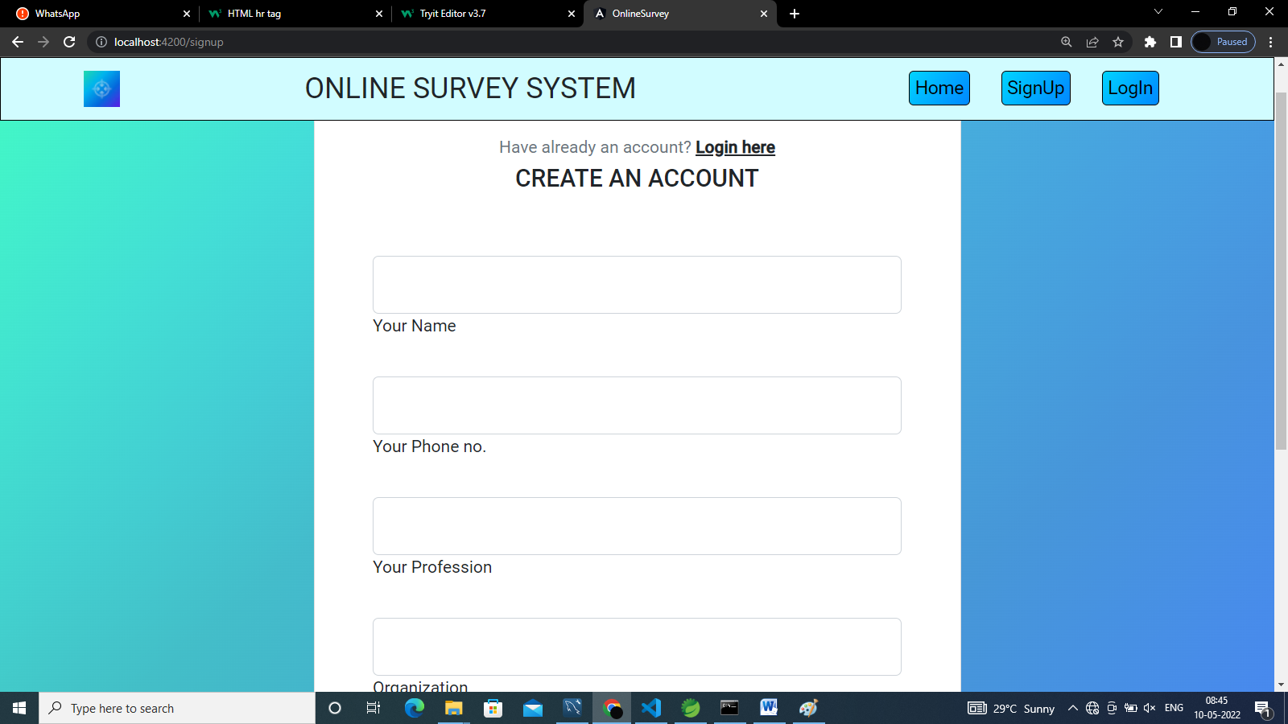
Sign up page

Slide 12
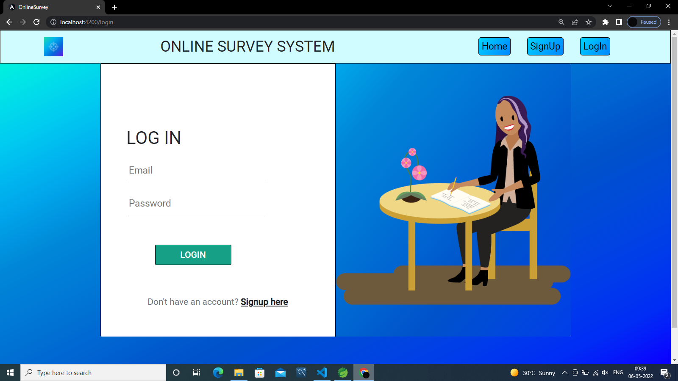
Login

Slide 13
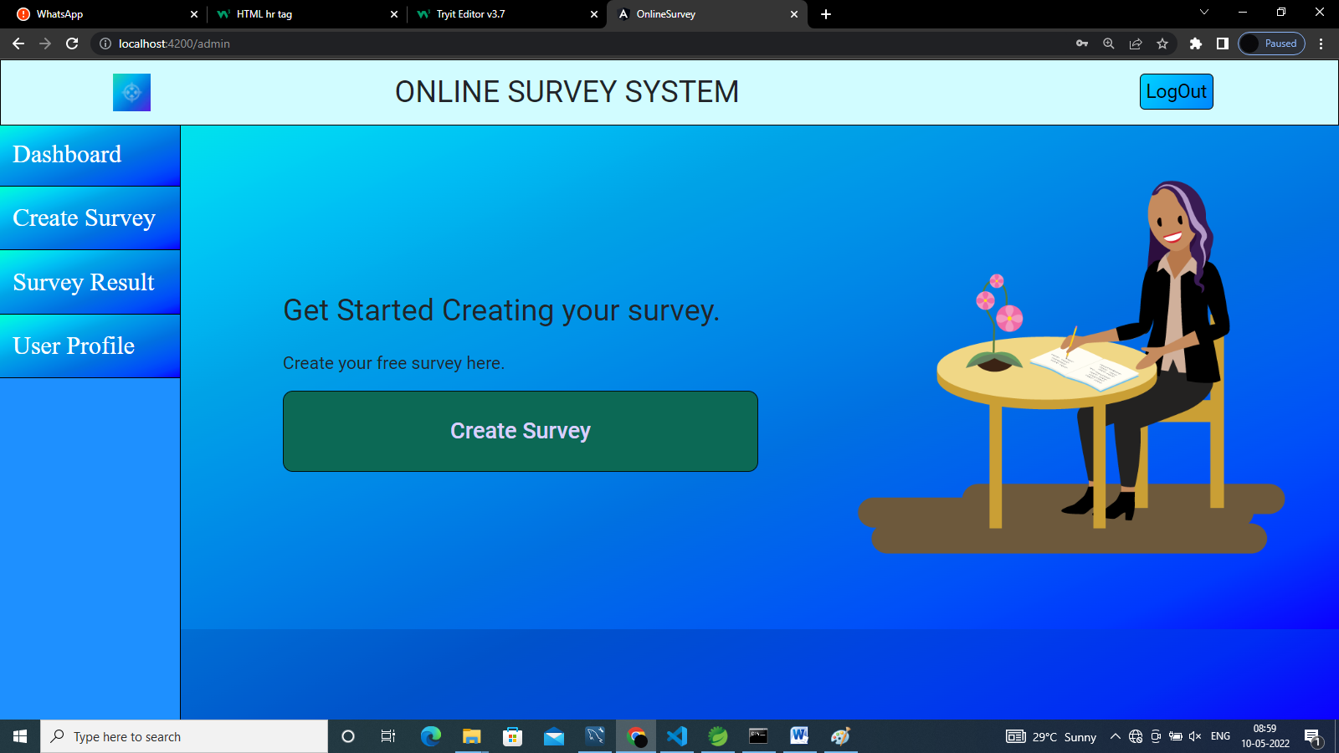
ADMIN MODULE

Slide 14
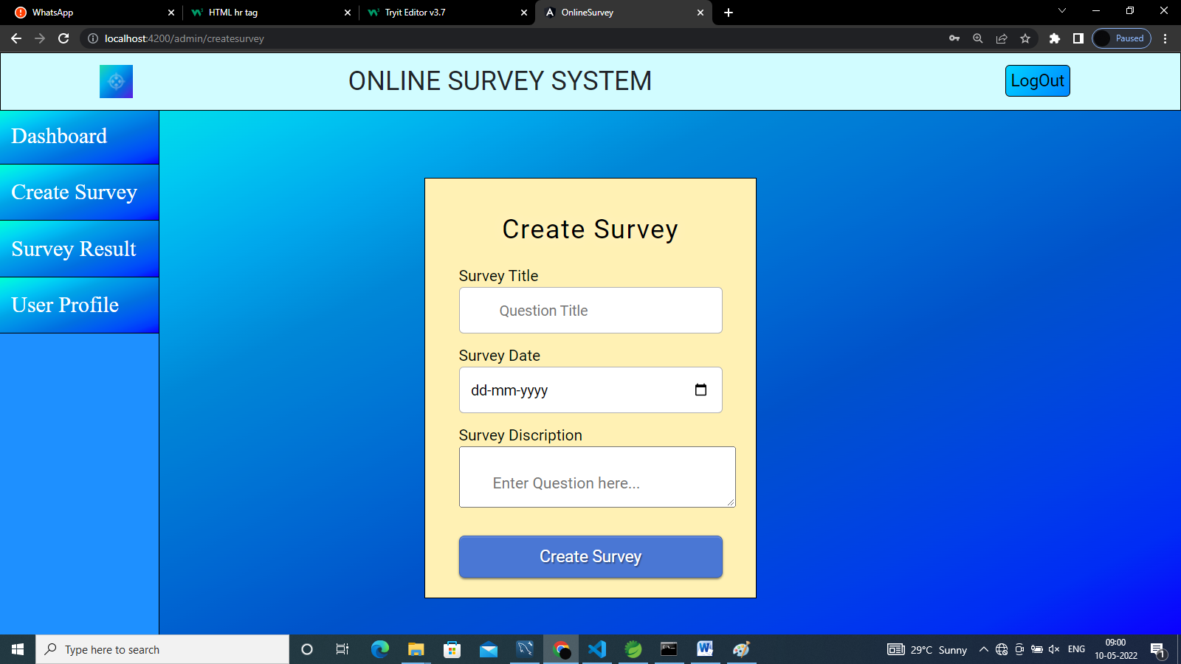
Create survey

Slide 15
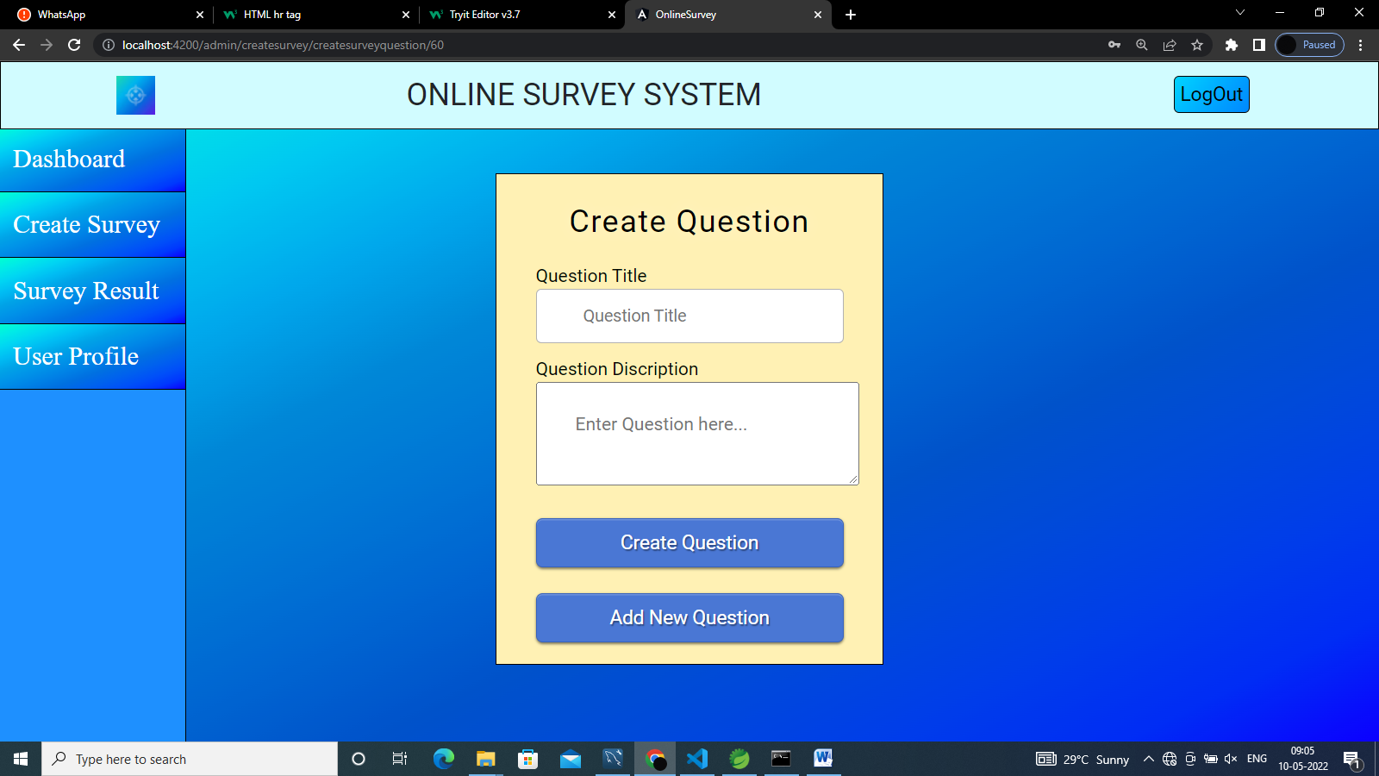
Create question

Slide 16
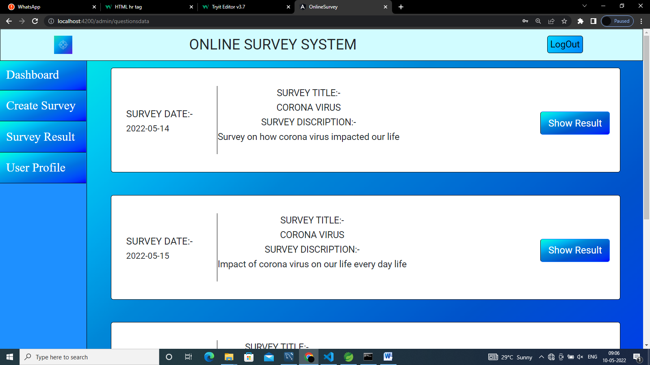
Survey list

Slide 17
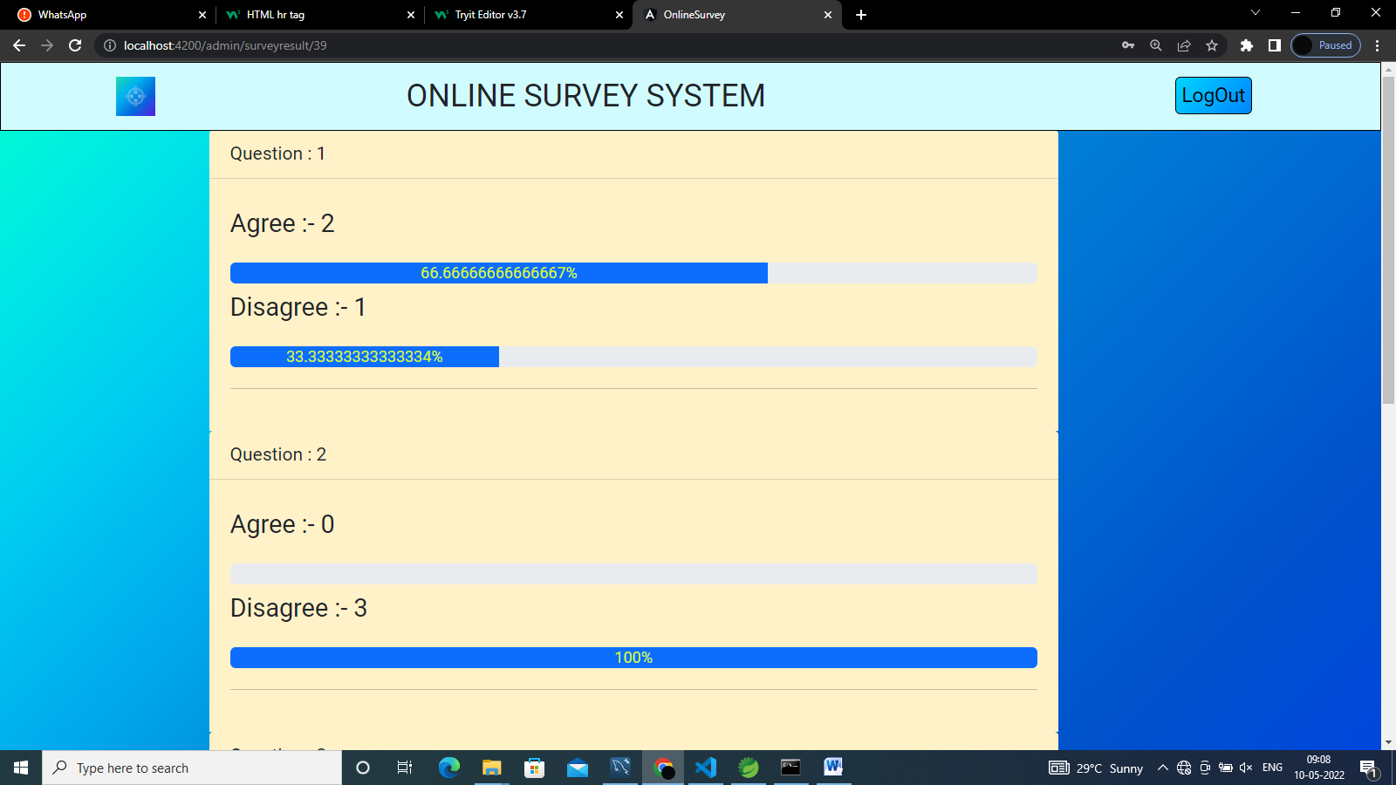
Survey result

Slide 18
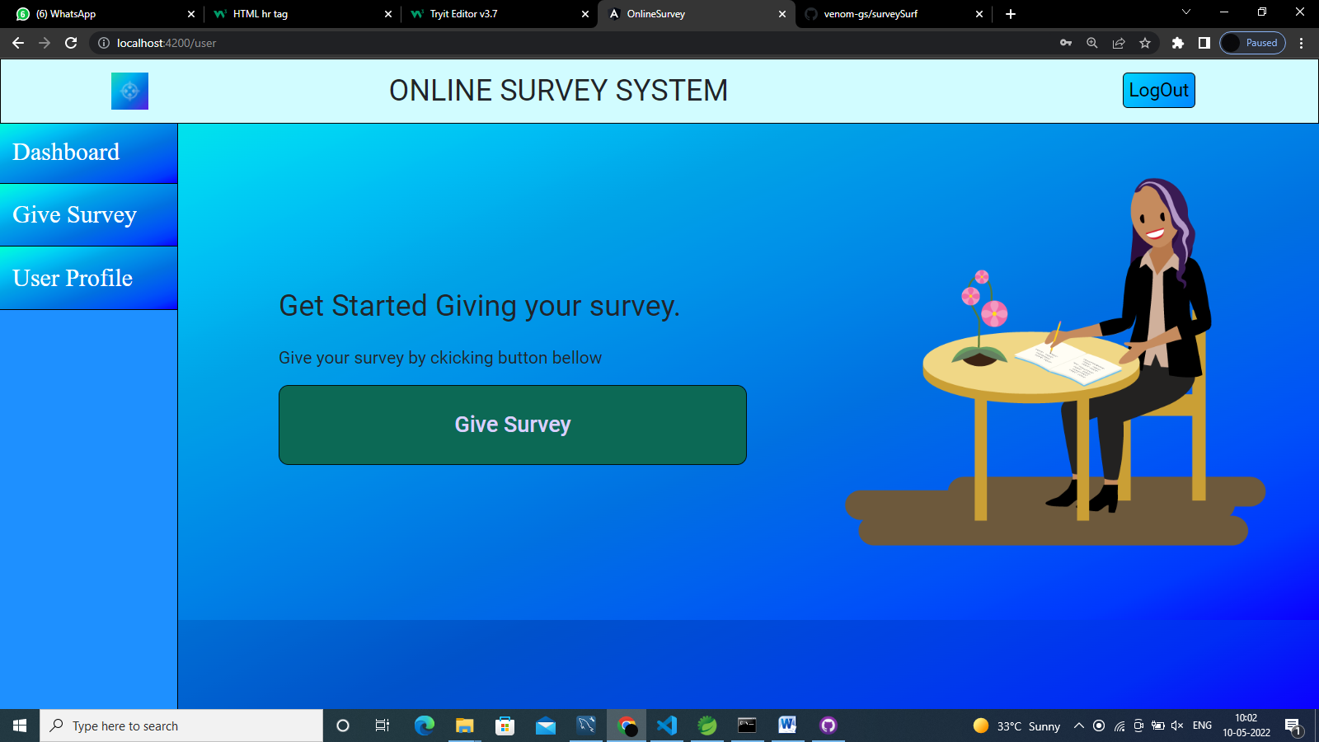
USER MODULE

Slide 19
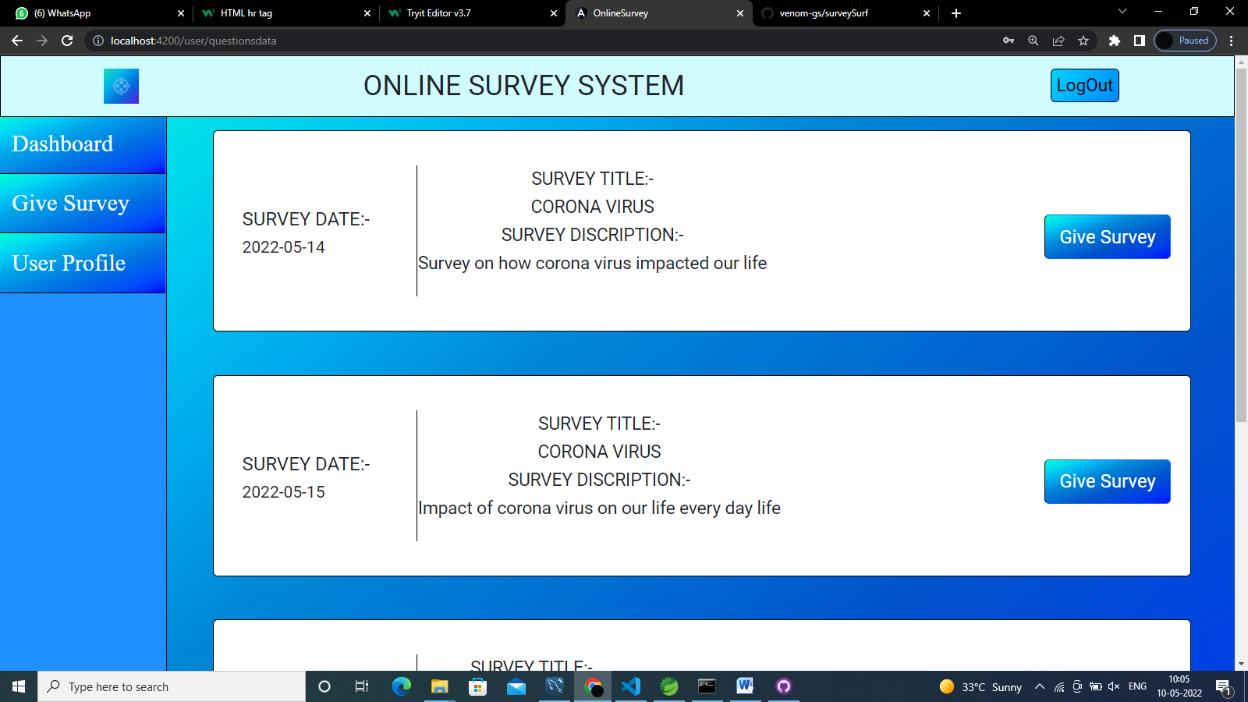
SURVEY list

Slide 20
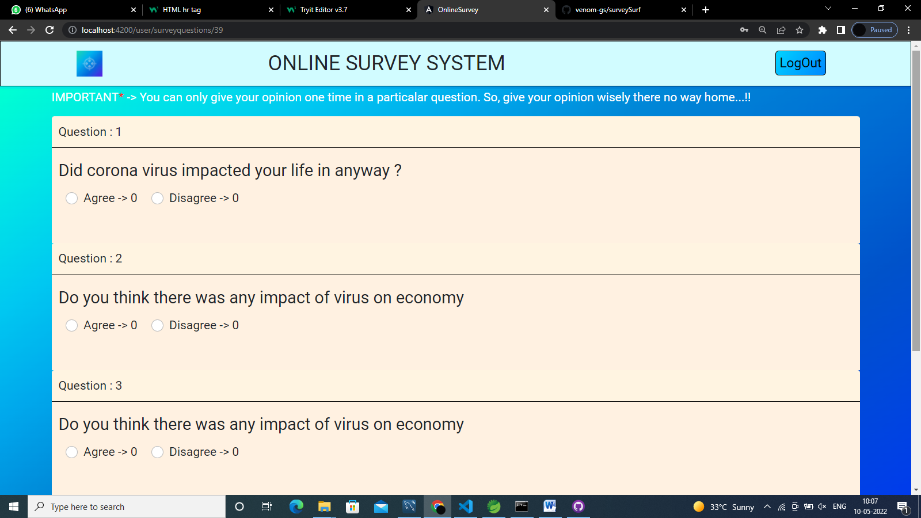
Give Answers

Slide 21
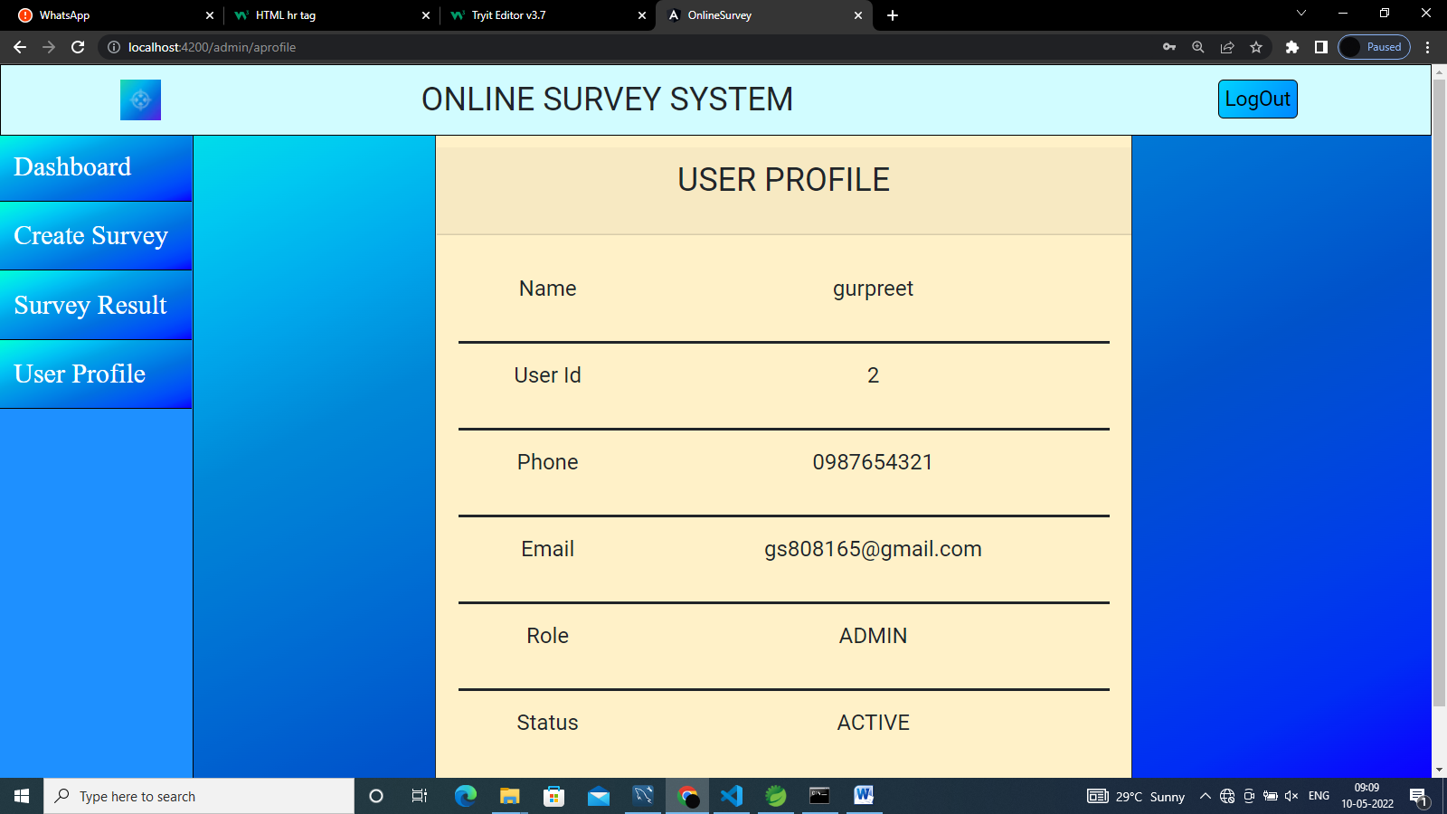
User profile

Slide 22
Scope Of improvements in near future
Ability to login directly with G-Mail Id.
Ability for admin to verify user.
Ability for admin to edit survey Question.
Ability to admin to delete users.
Ability for admin to edit survey.

Slide 23
GITHUB LINK
https://github.com/venom-gs/surveySurf

